Slide 1
Scene text detection based on Skeleton-cut detector
Supplementary Material
Xiang He Yonghong Song Yuanlin Zhang
We highlight some components of our skeleton-cut detector.
Next, we show some detection results on ICDAR 2013 and MSRA-TD500 benchmarks.
Contents
Overall process of skeleton-cut detector Section 1
Comparison of structure-edges and pixel-edges Section 2
Training samples for structured edge response(SER) Section 3
Edge maps obtained from SER Section 4
Skeletons construction and junctions detection Section 5
Detection results on ICDAR 2013 Section 6
Detection results on MSRA-TD500 Section 7

Slide 2

1 Overall process of Skeleton-cut detector
Structured Edge
Response Construction
Edge Maps
Segmentation
Skeletons
Construction
Skeletons-
Junctions
Detection
Skeletons
Cutting
Geometric Filtering
Text Line
Formation

Slide 3
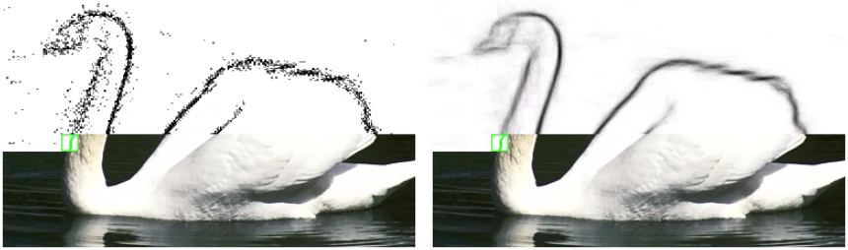
2 Comparison of Structure-edges and Pixel-edges
Compared to single pixel prediction, structured forest edge detection [1] is more robust and
coherent. In order to improve detection rate, we employ structure edge response to represent
the structural informations of objects.
Pixel-out edges
Structure-out edges

Slide 4
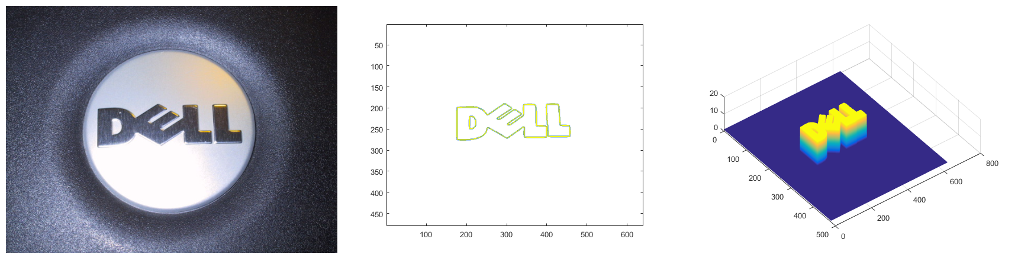
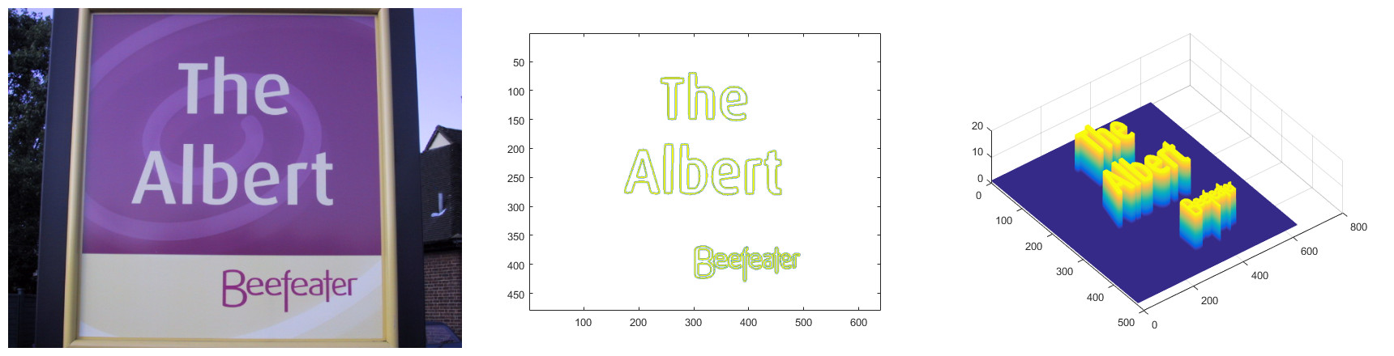
3 Training samples for structured edge response(SER)
Inspired by [2], we construct a training dataset that is specific to compute structural edge response for text. In our proposed dataset, one training sample consists of a scene image, a boundary map and a segmentation map shown as below:
Training images
Training boundaries
Training segmentations

Slide 5
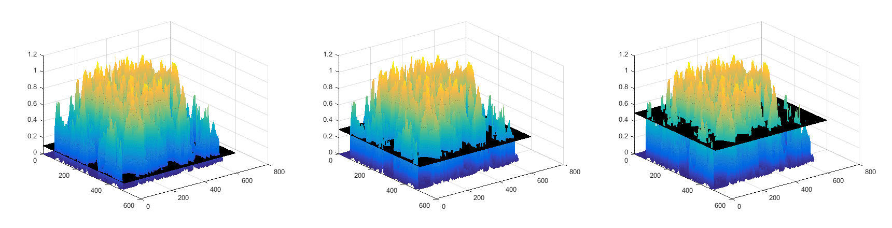
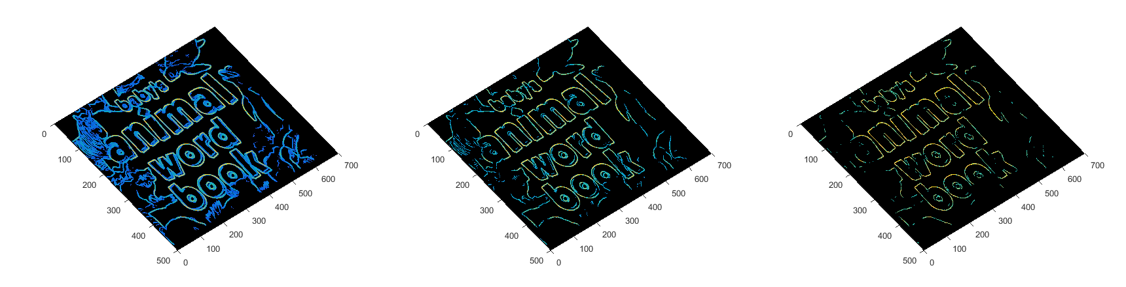
4 Edge maps obtained from SER
To extract text-specific edges from background, we segment the structured edge response into a range of binary edge maps through different thresholds. As illustrated in the following edge maps, the biggest challenge for extracting edges of text is how to solve the edge-adhesion problem:
Segmentation
Threshold
t = 0.1
t = 0.3
t = 0.5

Slide 6

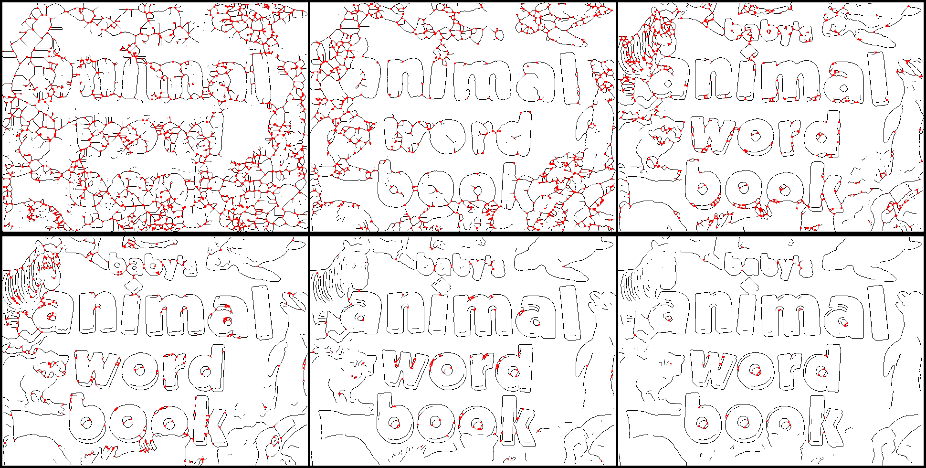
5 Skeletons construction and junctions detection
Skeleton-junctions detection and elimination are performed on these edge maps to cut text-specific edges from background. The resulting text-skeletons are shown as the minimally connected 1-pixel-width strokes or rings in the left column. And junctions are detected as red points in the right column.
Skeletons construction
Skeleton-junctions detection

Slide 7
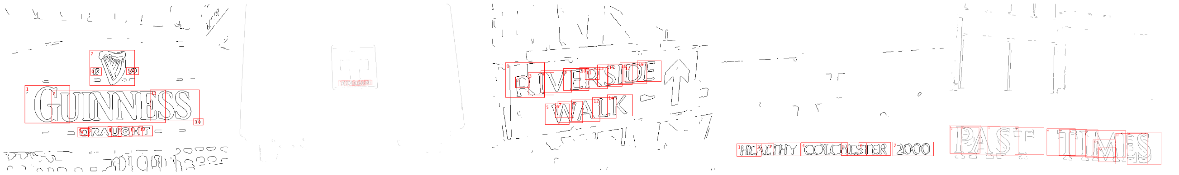
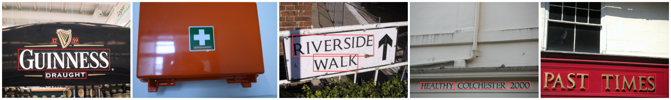
6 Detection results on ICDAR 2013
Example detections on the ICDAR 2013 dataset: at the bottom row, we combine ILR with skeleton-cut detector, giving the final detection results.
Skeleton-cut :
Skeleton-cut + ILR:

Slide 8
6 Detection results on ICDAR 2013
Example detections on the ICDAR 2013 dataset: at the bottom row, we combine ILR with skeleton-cut detector, giving the final detection results.
Skeleton-cut :
Skeleton-cut + ILR:

Slide 9
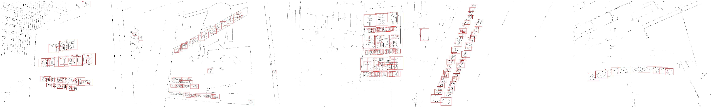
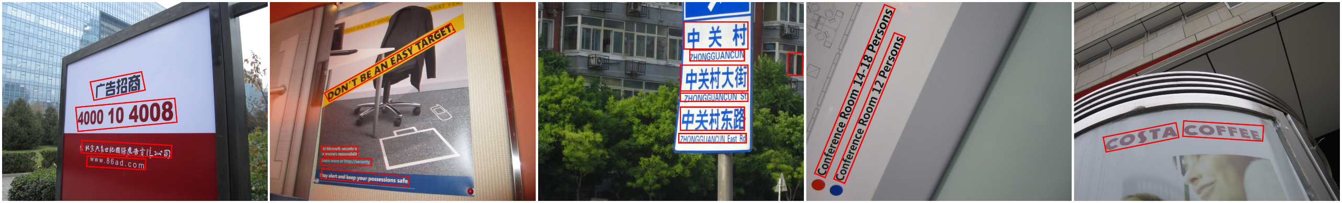
7 Detection results on MSRA-TD500
Experimental results on public benchmarks, ICDAR 2013 and MSRA, demonstrate that our algorithm achieves the state-of-art performance.
Skeleton-cut :
Skeleton-cut + ILR:

Slide 10
Reference
[1] Dollar P, Zitnick C L. Fast Edge Detection Using Structured Forests[J]. IEEE Transactions on Pattern Analysis & Machine Intelligence, 2015, 37(8):1558-1570.
[2] Arbelaez P, Maire M, Fowlkes C, et al. Contour detection and hierarchical image segmentation[J]. IEEE transactions on pattern analysis and machine intelligence, 2011, 33(5): 898-916.

Slide 18
7 Detection results on MSRA-TD500
Experimental results on public benchmarks, ICDAR 2013 and MSRA, demonstrate that our algorithm achieves the state-of-art performance.
Skeleton-cut :
Skeleton-cut + ILR:

